Slide 1
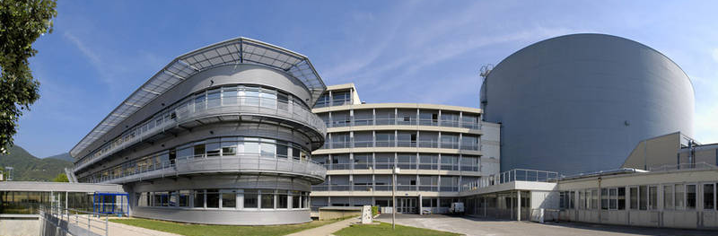

The ILL Joins the Mantid Project
Dr Ian Bush, Dr Gagik Vardanyan, Mrs Verena Reimund, Dr Antti Soininen, Dr Miguel Gonzàlez
Notes:
Thank you for the introduction.
Gagik was originally meant to give this talk, but he unfortunately could not make it, so I am giving it in his place.

Slide 2
Talk Overview
Mantid and Adoption at the ILL
Working with the Mantid Team
Lamp and Mantid Comparison
Framework changes to support the ILL
Workflows
Time of Flight
Backscattering
Future work
Notes:
(As bullet points)

Slide 3








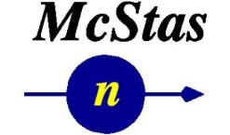

The Mantid Project – Neutron Data Reduction
Notes:
For those of you who may not know Mantid is a framework to support neutron data reduction.
The project started at ISIS, the SNS have been members for some time now, and the ESS have also joined the project. There are also a number of contributing institutions to the Mantid code. This where ILL has been previously, some work being done as a proof of concept for using Mantid, but now we are signing(ed) up as full partners.

Slide 4

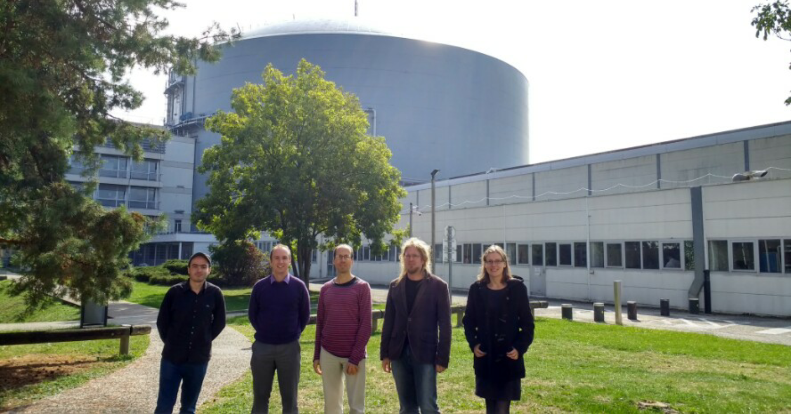
The Bastille Project for Mantid Adoption
Bastille project, part of ILL’s Endurance programme, to support 20 ILL instruments after 3 years, replacing Lamp
People involved:
Antti Soininen, Verena Reimund, Gagik Vardanyan
Ian Bush – technical lead for one year – from Tessella
Miguel Gonzàlez – scientific lead for the project – from ILL’s CS Group
Notes:
The Bastille project is part of ILL’s Endurance programme. The Endurance programme has a number of scientific aims, such as instrument upgrades and sample environment improvements. The Bastille project in Endurance is an effort to improve data reduction and analysis. A large component of this is for Mantid adoption.
3 new developers, brand new to the Mantid project. Antti has been working at MLZ for the three years prior to joining the ILL. Verena has a background in electrical engineering and C++ development, while Gagik recently finished his PhD at CERN.
Then there is myself, who is the technical lead for the project, from Tessella, so with some prior experience of Mantid.
Finally there is Miguel Gonzalez, who has been based at ILL for a number of years, and has developed Lamp, ILL’s existing data reduction package. So Miguel is the scientific lead for the project, with the knowledge of the existing data reduction approach at the ILL.
https://www.ill.eu/de/about/zukunftsplaene/endurance/the-endurance-projects-june-2013/

Slide 5





Working with the Mantid Team
Notes:
Integrating with the rest of the Mantid team has been made a lot eaiser through using the right tools. There is of course nothing better than meeting face to face, but other than at events like this one, it is difficult to do.
GitHub is used for version control, but the PR system is also great for remote working. It makes code reviews easy even in the situation where you could not sit down and talk to some about it.
Using Jenkins makes it easy to verify the pull requests pass the unit tests and static analysis checks, and pass on all platforms. It means we do not have to worry about setting up builds for all the supported platforms at ILL straight away. The integration between Jenkins and GitHub makes the checks very easy to keep track of.
Slack is used for the day-to-day communication, and makes it easy to talk to someone about a piece of code, or ask questions of the whole team.
Finally, the usual video conference tools for things like the Mantid review meetings and meetings for the technical steering committee are the closest we get to the regular face-to-face meetings.
Starting out was a good example of using these tools, the new starters at ILL ran through some training exercises, opened PRs on GitHub, checked by Jenkins. Then we had meetings via Skype to discuss some of the exercises, and followed up with a few changes discussed on Slack.

Slide 6
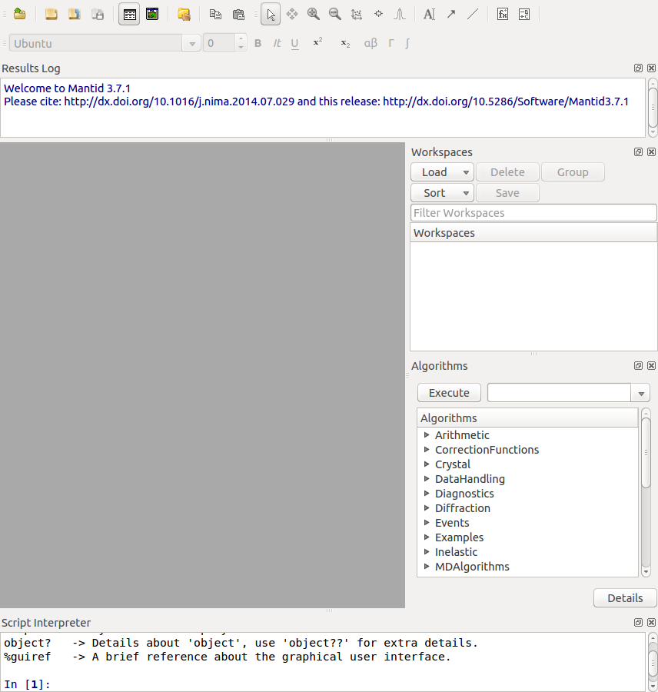
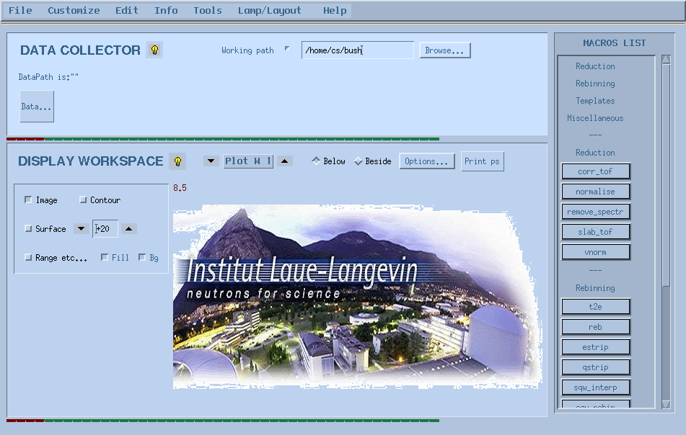
Lamp and Mantid
Notes:
I will just say a bit more about Lamp and Mantid. Lamp has been in development for over 20 years at the ILL. This means it has great support for data reduction on the ILL instrument, going back to when it first started. This can make it hard to understand the many branches in the code, so the plan with Mantid is to only support data going forward. It is based in IDL, so does have good cross platform support.
Mantid was chosen for adoption primarily due to the opportunity to share effort and collaborate with other institutions in the neutron scattering community that I mentioned earlier. As well as shared effort this provides a common software framework for users who may be working at more than one facility.
However, Mantid and Lamp do have fairly similar approaches to things.

Slide 7
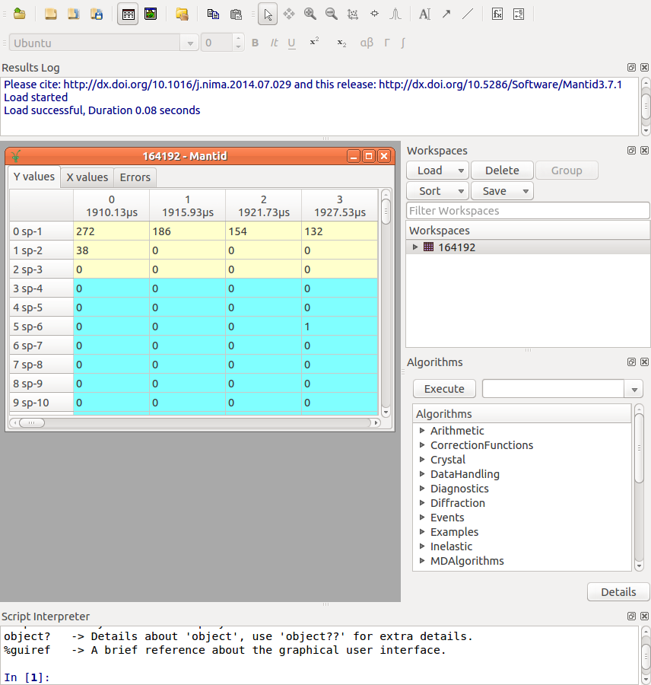
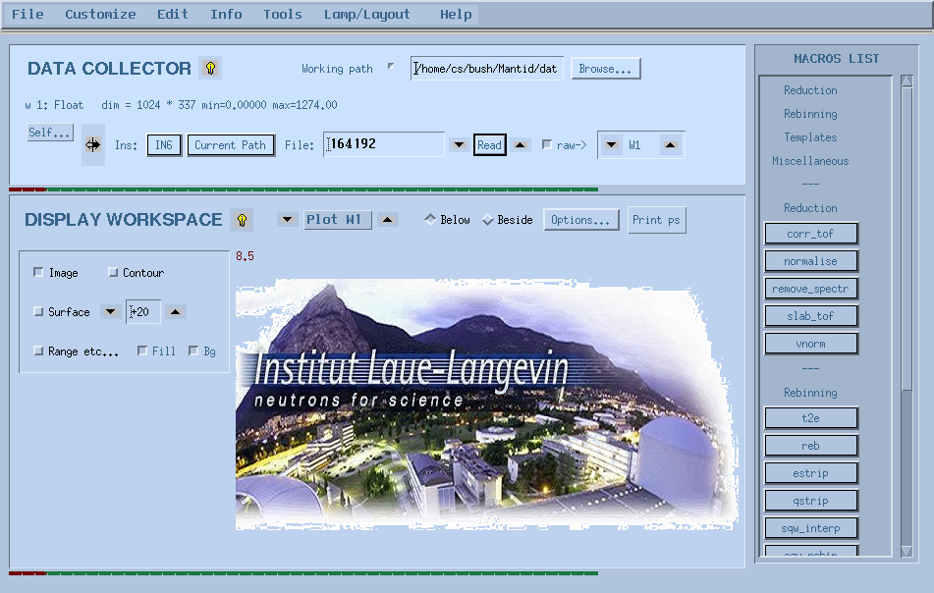
Lamp and Mantid
Workspaces
Notes:
Both have workspaces, for loading and manipulating data…

Slide 8
Lamp and Mantid
Algorithms
Notes:
… both have algorithms, in Lamp’s case they are called macros…

Slide 9
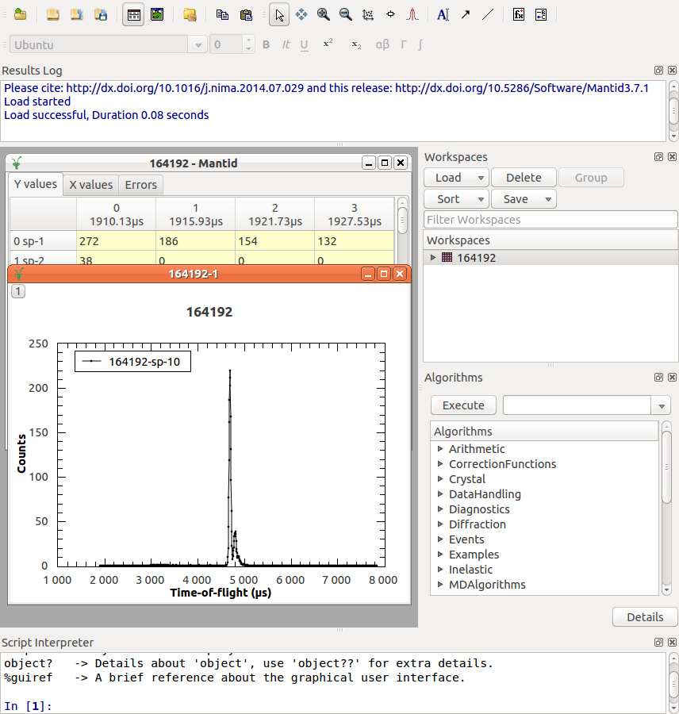
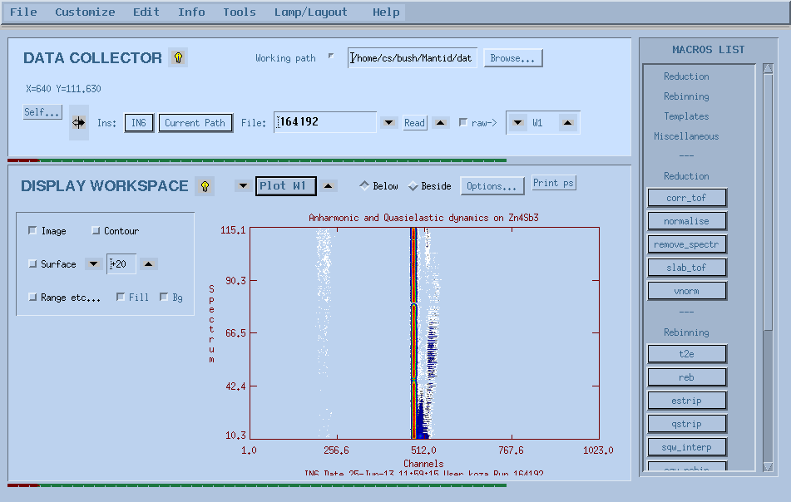
Lamp and Mantid
Plotting
Notes:
… both have plotting functionality…

Slide 10
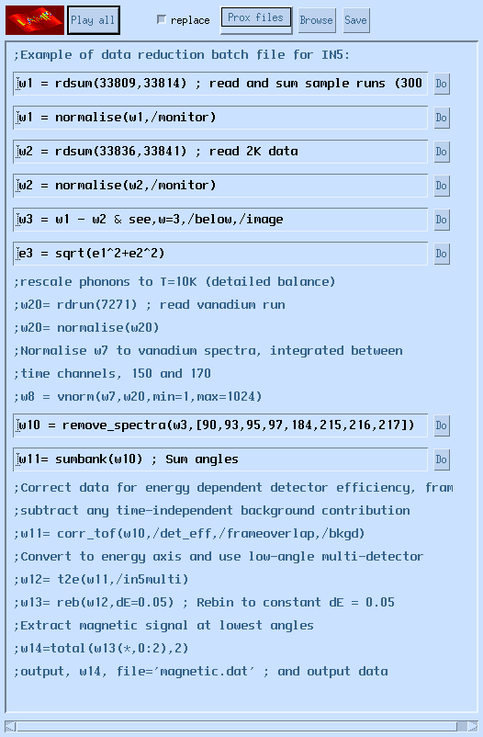
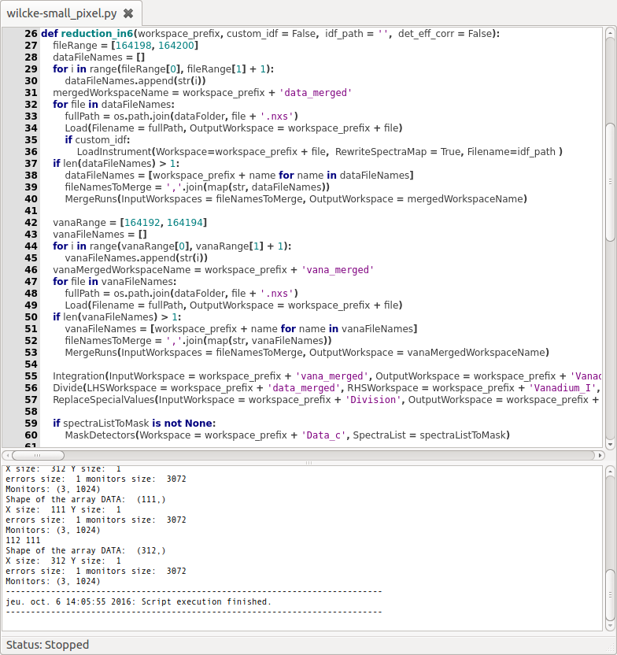
Lamp and Mantid
Scripting
Notes:
and both have scripting capabilities. One of the other advantages of switching to Mantid is that the scripting capability is in Python, which is more widely used in the scientific community than IDL.

Slide 11
ILL Workflows
Started with DGS Time-of-Flight Spectrometers (IN4/5/6) and Backscattering (Indirect Geometry) instruments (IN16B)
Initial work started by:
Ricardo Ferraz-Leal (loaders, instrument definitions, sample scripts)
Spencer Howells and Elliot Oram (IN16B workflow)
Work on workflows themselves, and features required to support them, for example
File loading, filtering and merging
Flat background moving window average
Incident energy calibration for DGS Instruments
Notes:
General introduction, workflows in Lamp, workflows in Mantid

Slide 12
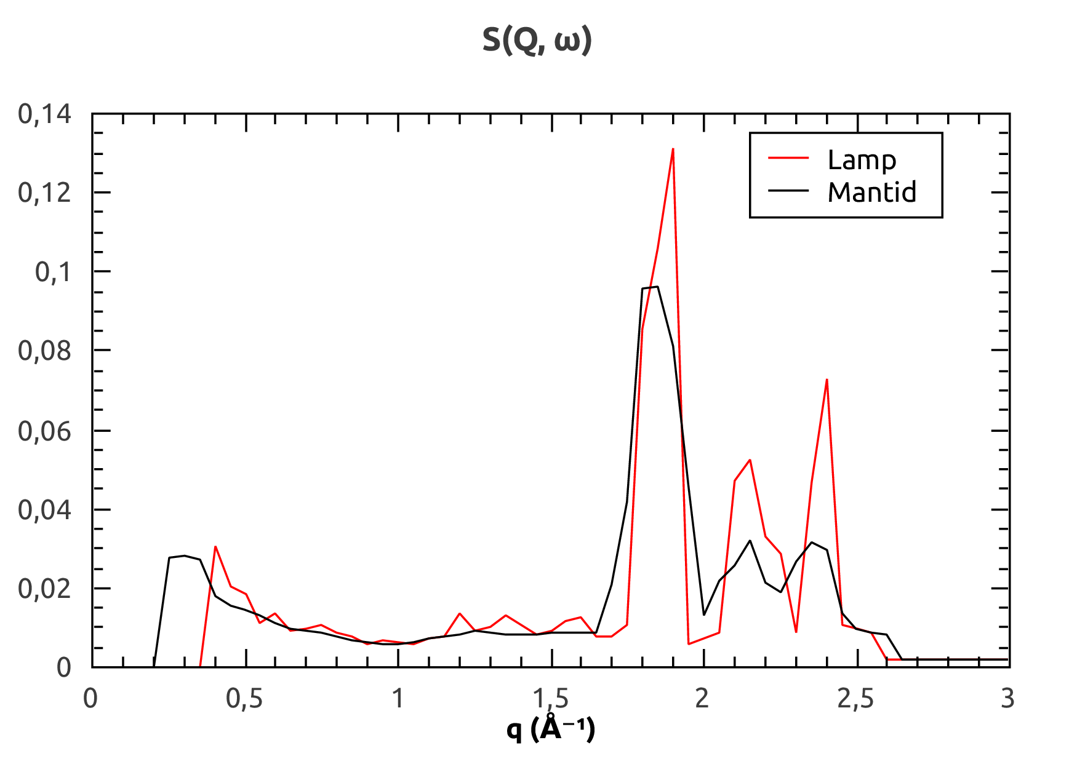
Time-of-Flight Workflow – S(Q,ω) Comparison
Notes:
Illustrate reasons for differences (ignoring geometry/taking it into account), show point comparison

Slide 13
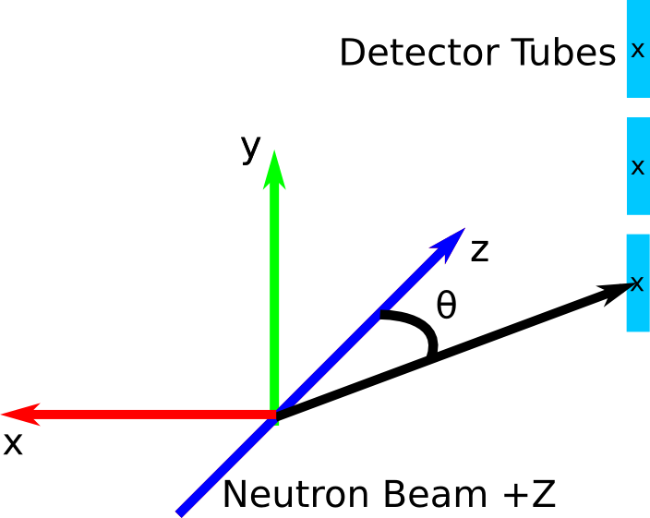
Time-of-Flight Workflow – S(Q,ω) Comparison
Notes:
Illustrate reasons for differences (ignoring geometry/taking it into account), show point comparison

Slide 14
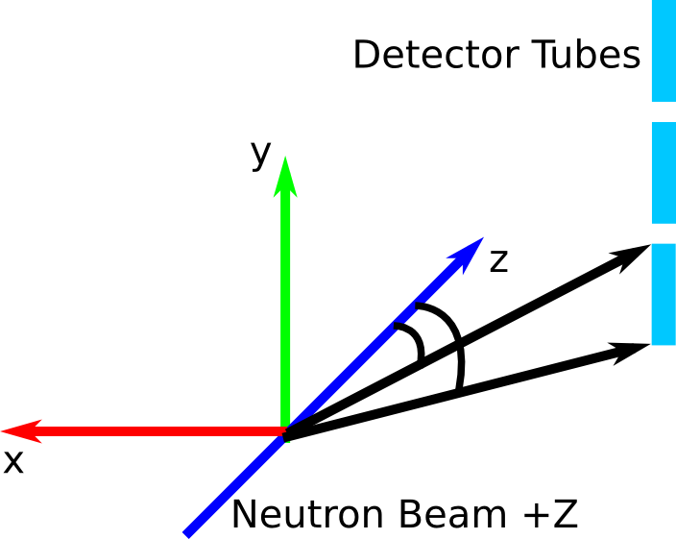
Time-of-Flight Workflow – S(Q,ω) Comparison
Notes:
Illustrate reasons for differences (ignoring geometry/taking it into account), show point comparison

Slide 15
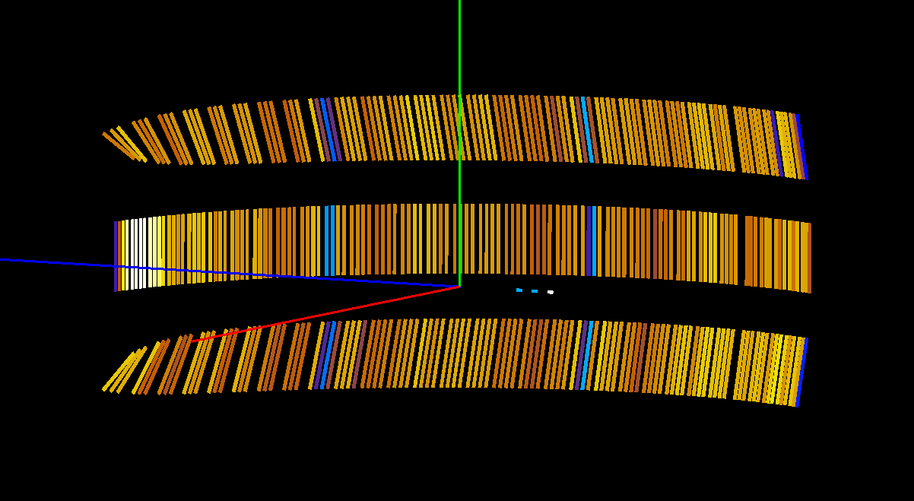
Time-of-Flight Workflow
Instrument Definition – IN6 Original
Notes:
Nice animation of differences

Slide 16
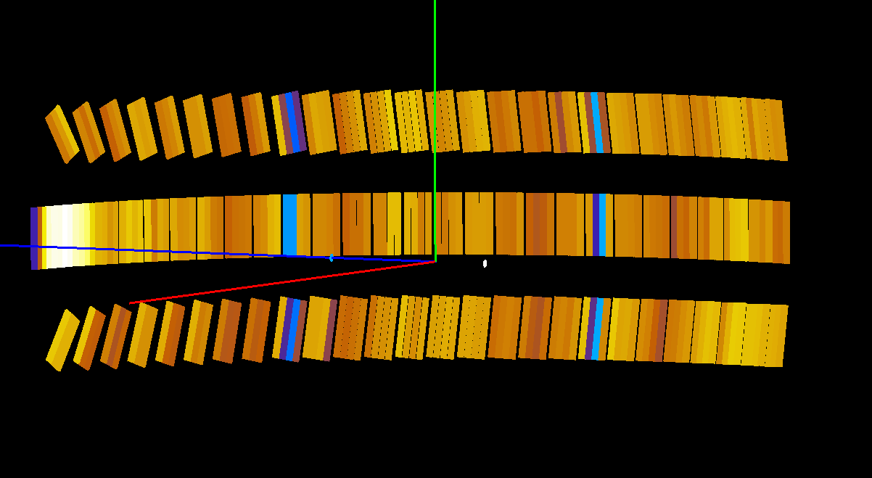
Time-of-Flight Workflow
Instrument Definition – IN6 Updated
Notes:
Nice animation of differences

Slide 17
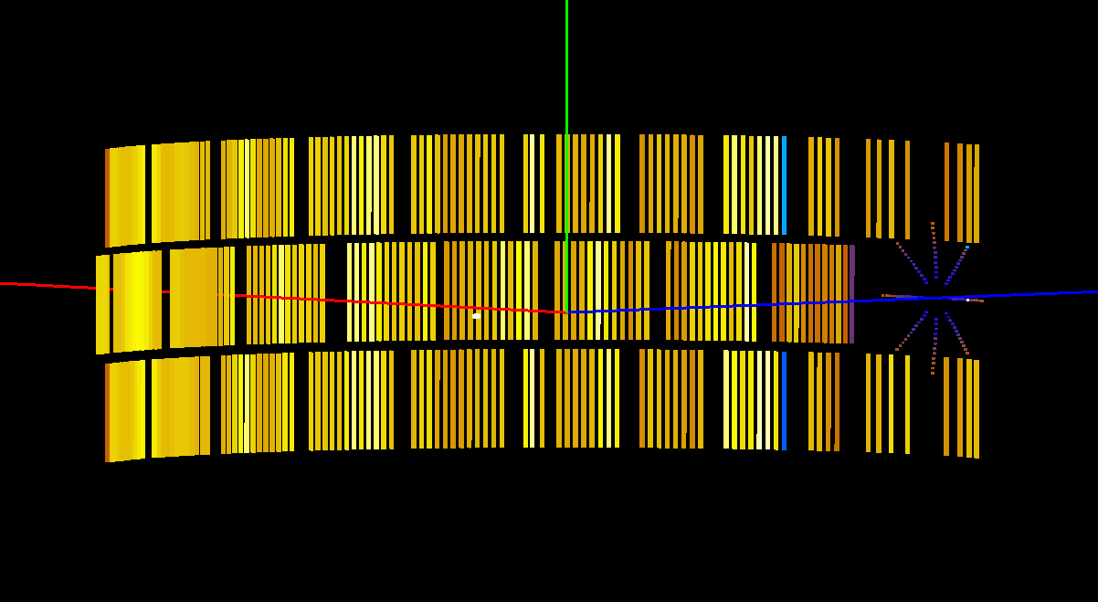
Time-of-Flight Workflow
Instrument Definition – IN4 Original
Notes:
Nice animation of differences

Slide 18
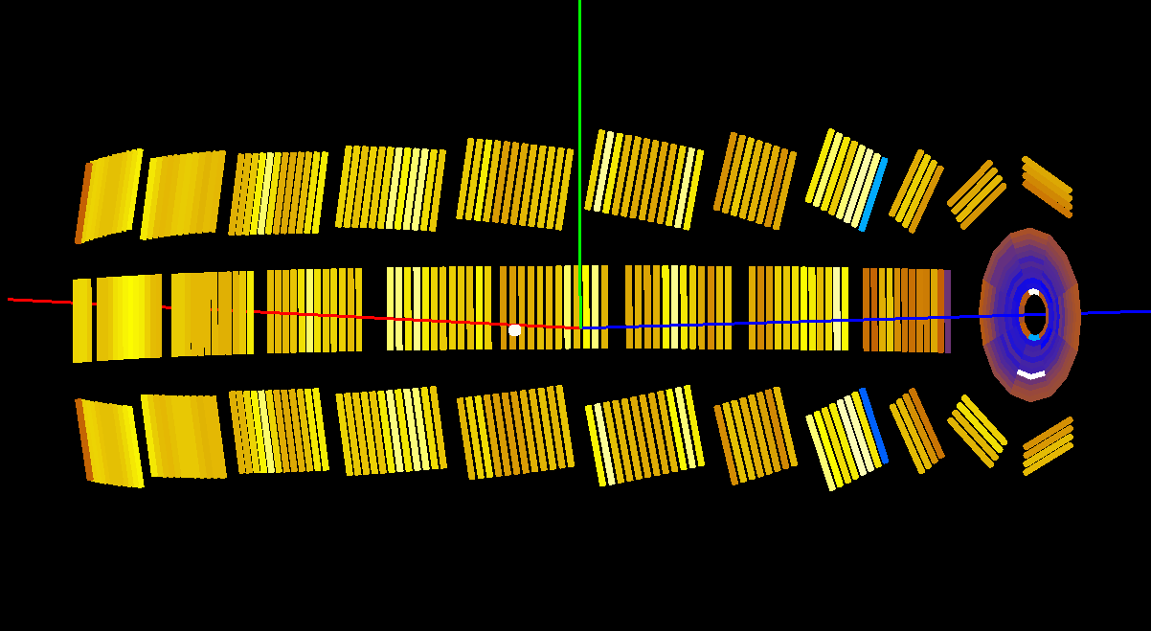
Time-of-Flight Workflow
Instrument Definition – IN4 Updated
Notes:
Nice animation of differences

Slide 19
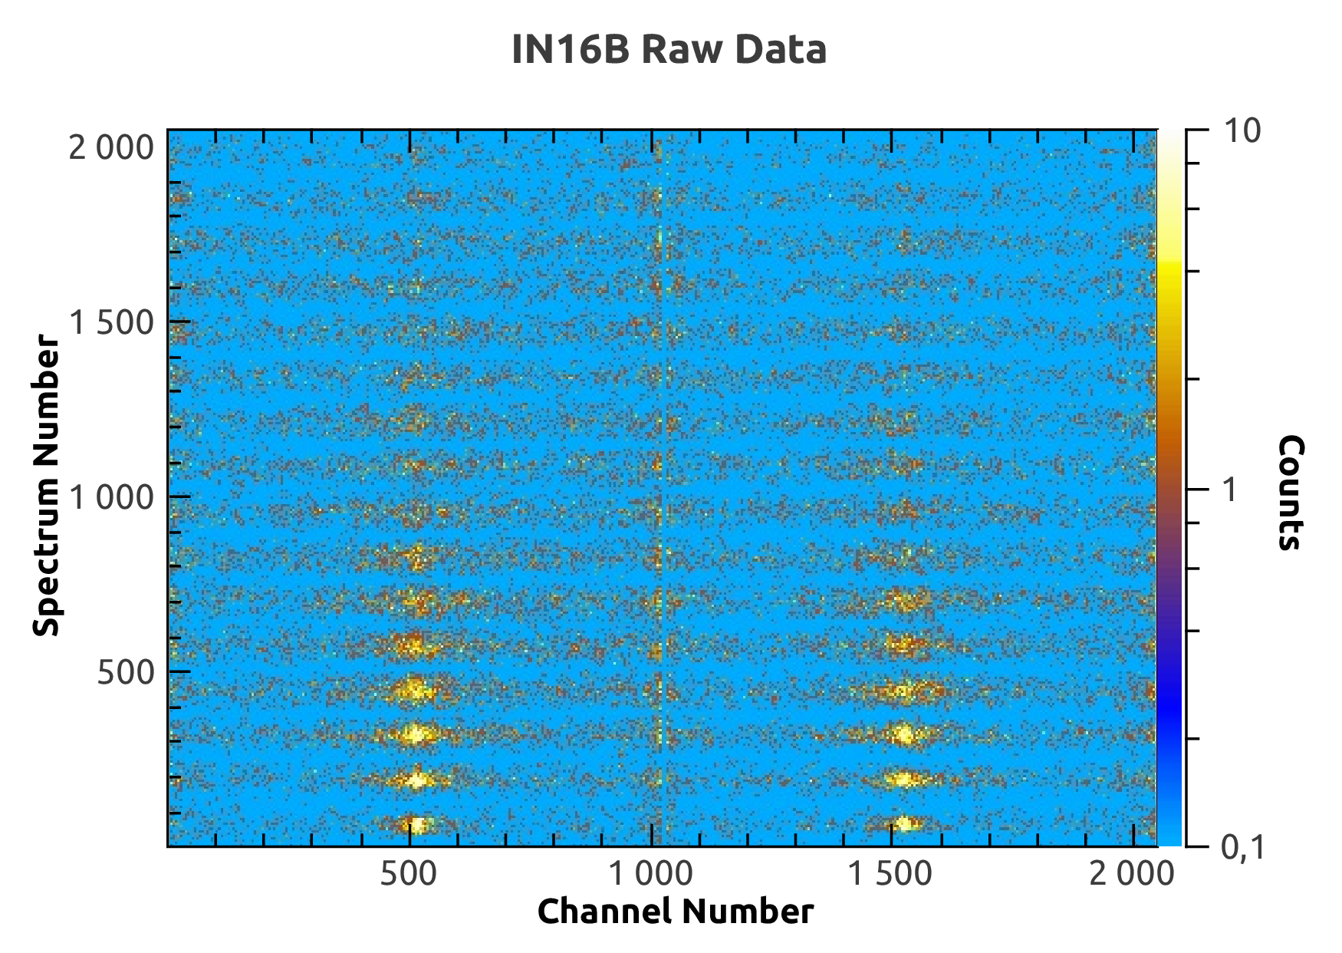
Backscattering Workflow

Slide 20
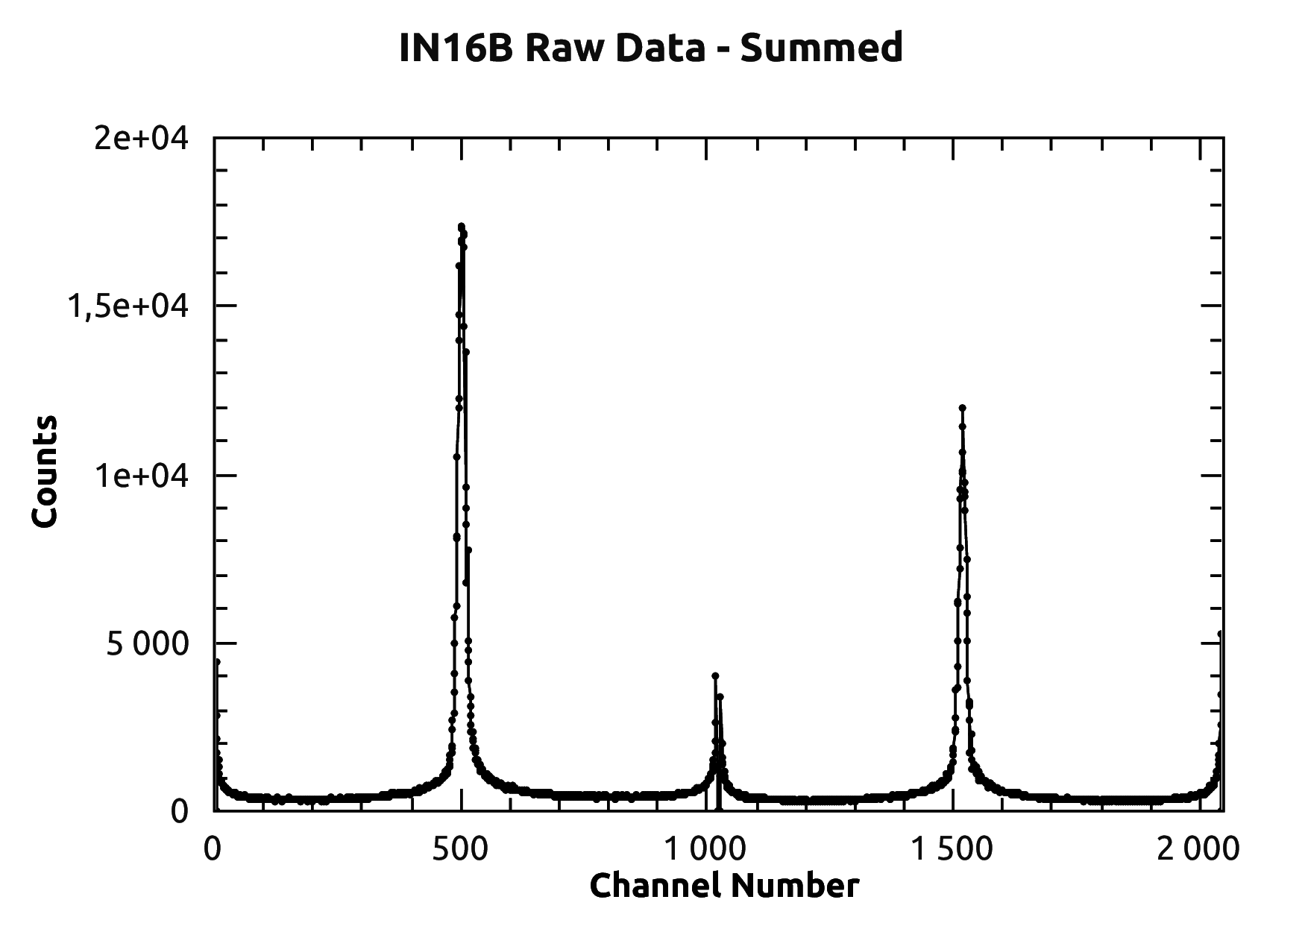
Backscattering Workflow
Elastic Peaks
Left Workspace
Right Workspace

Slide 21
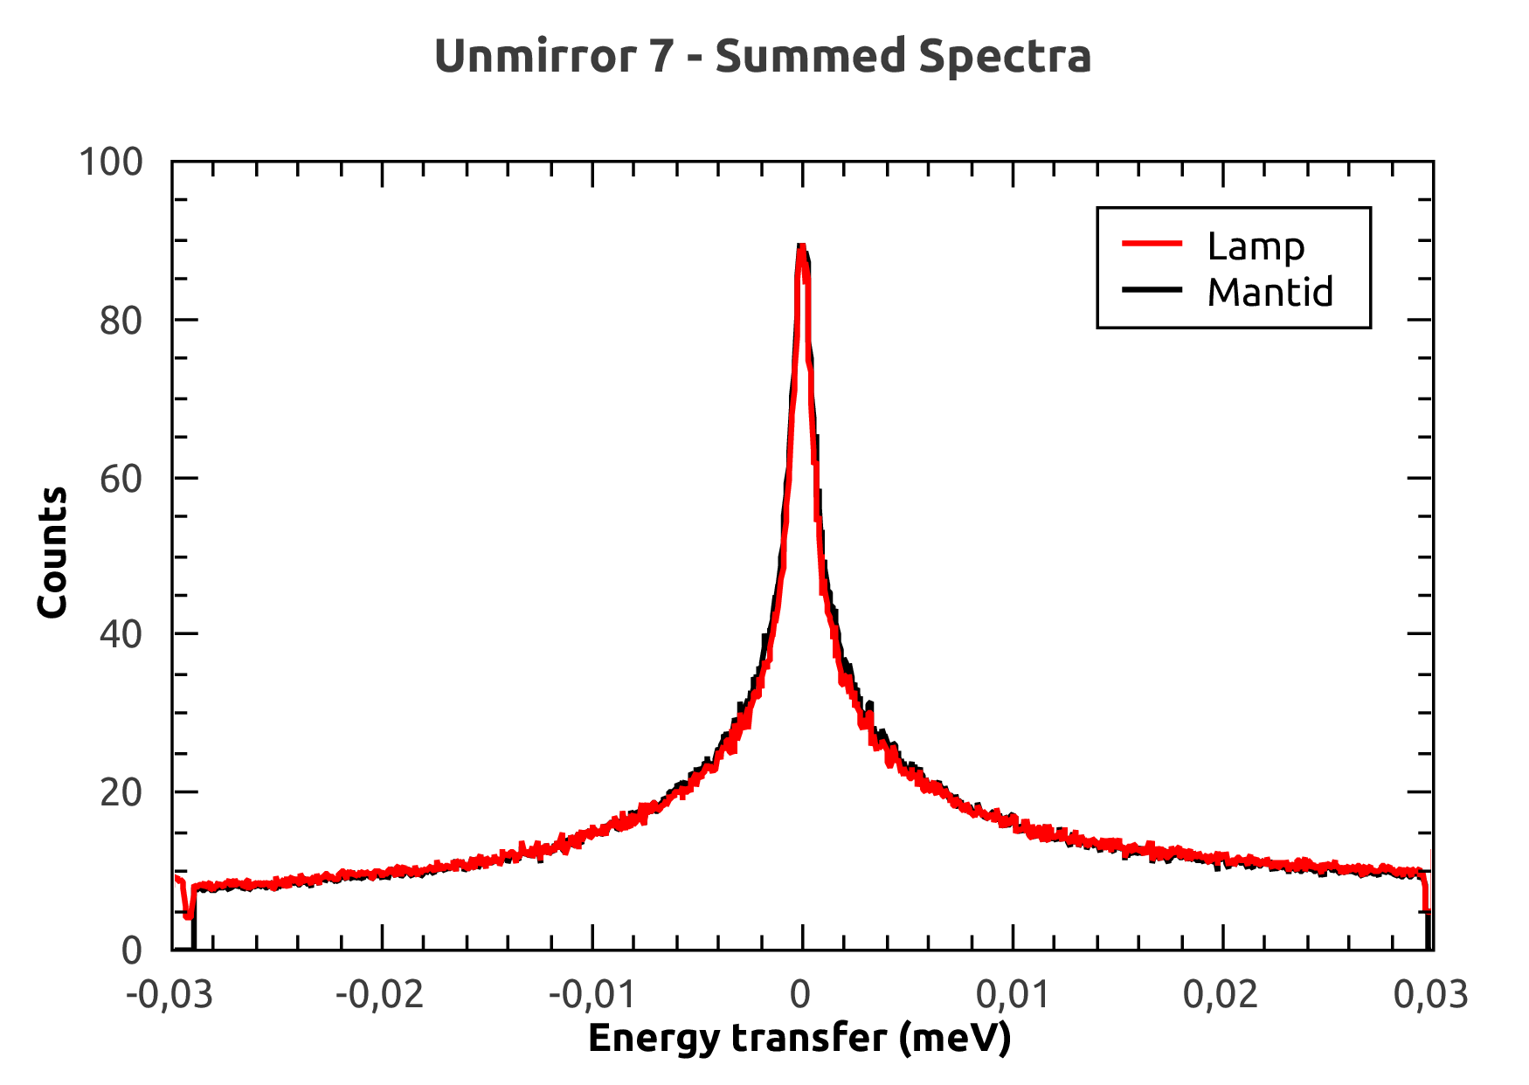
Backscattering Workflow – Lamp and Mantid

Slide 22
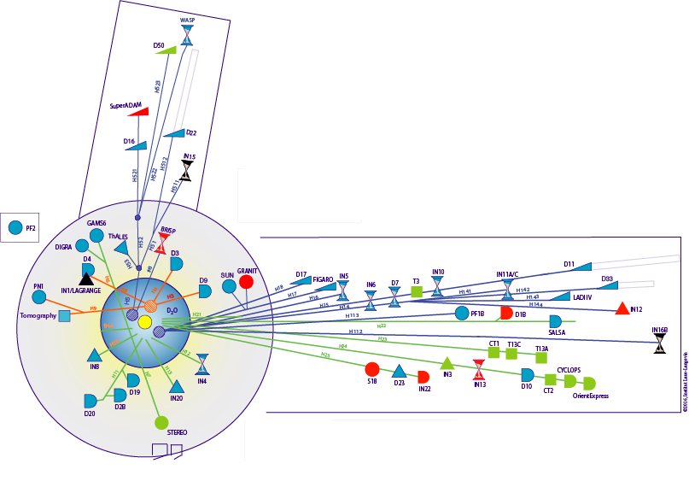
Future Work – Technique Areas
Started on ToF and Backscattering…
…SANS…
…reflectometry…
…diffraction

Slide 23
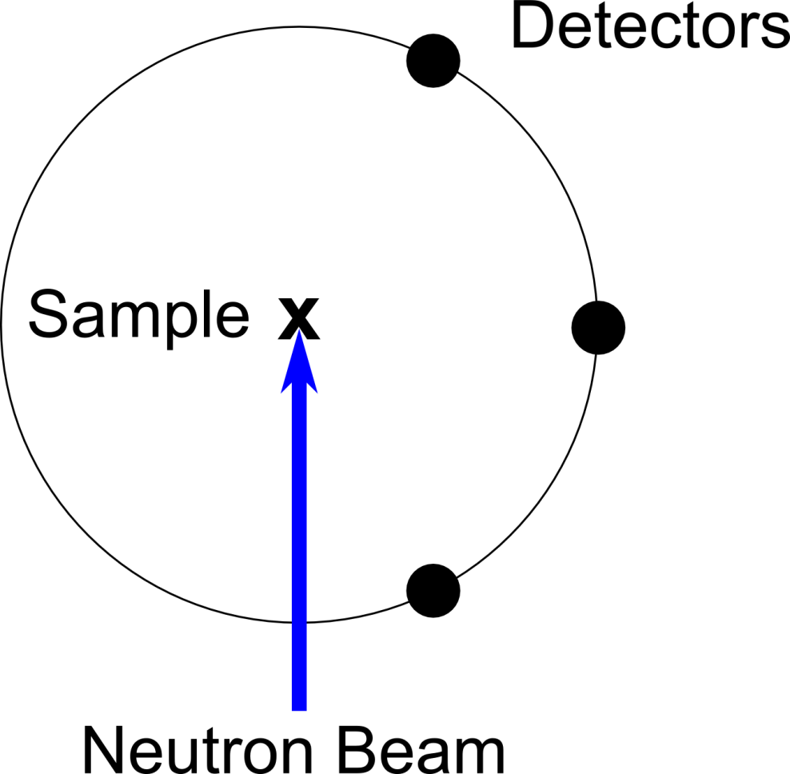
Future Work – Scanning Instruments
Support the instruments at ILL with movable detectors, such as D2B, D4 and D7
D2B – Powder
Diffractometer

Slide 24
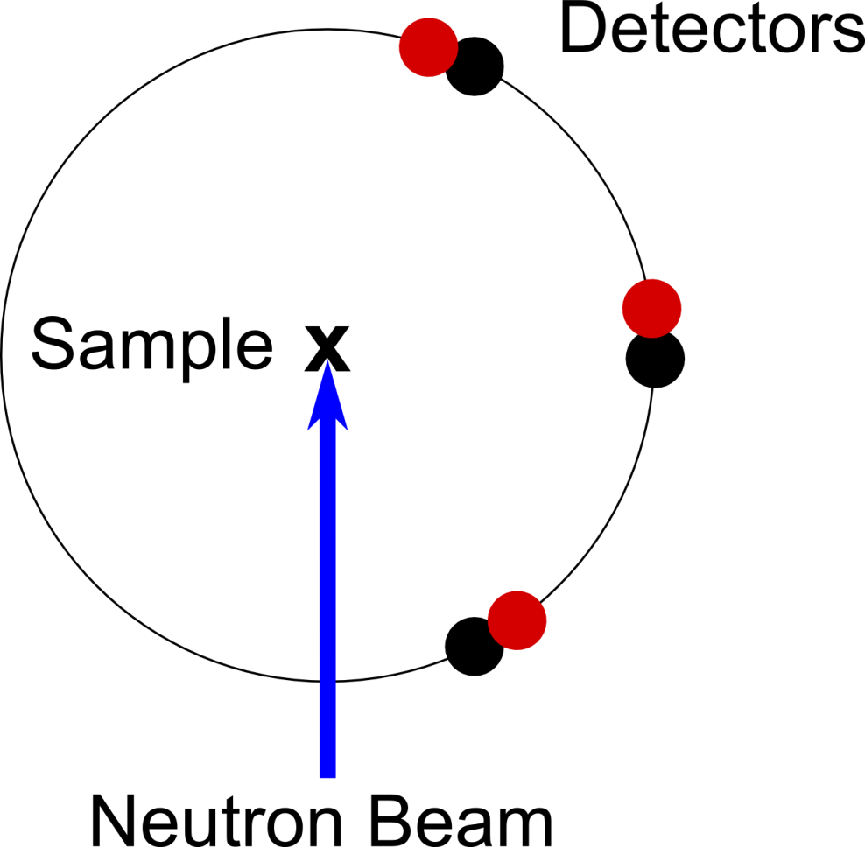
Future Work – Scanning Instruments
Support the instruments at ILL with movable detectors, such as D2B, D4 and D7
D2B – Powder
Diffractometer

Slide 25
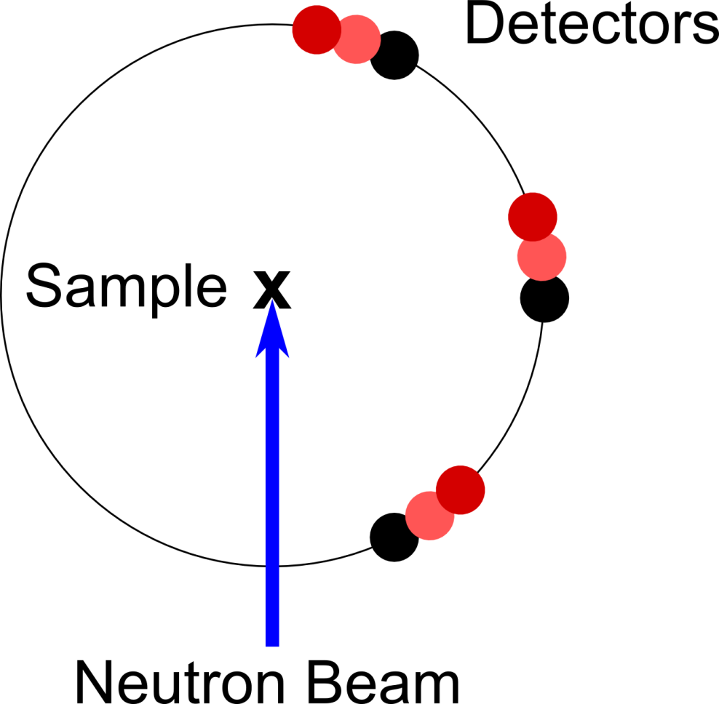
Future Work – Scanning Instruments
Support the instruments at ILL with movable detectors, such as D2B, D4 and D7
D2B – Powder
Diffractometer

Slide 26
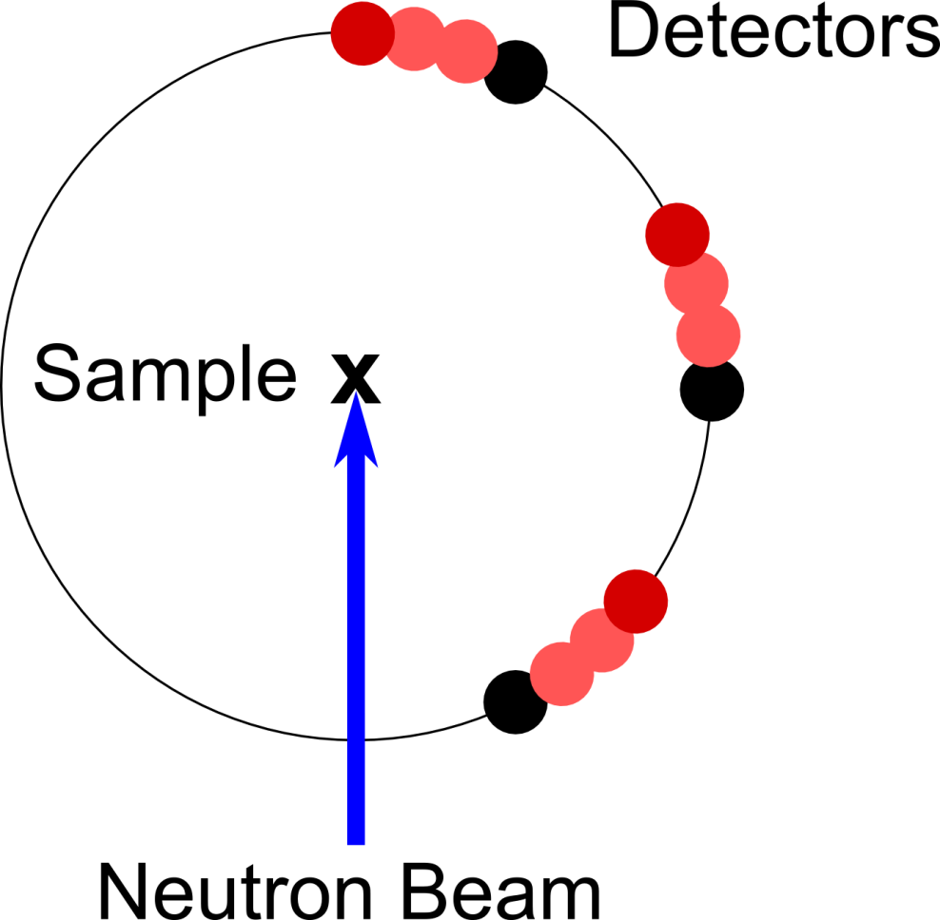
Future Work – Scanning Instruments
Support the instruments at ILL with movable detectors, such as D2B, D4 and D7
D2B – Powder
Diffractometer

Slide 27
Future Work, Summary and Conclusions
SINE2020 funding for Mantid on continuous sources
Data analysis work at the ILL
QENS
Simulation
Mantid adoption under way at the ILL…
… but lots still a long way to go
Thanks for listening!

